Slide 1

Web Scraping
ZOLO.CA

Slide 2
ZOLO.CA
Real estate website
Houses and condos exclusively For Sale
Operates only in Canada
Mainly big cities
7000 listings in Toronto

Slide 3
Why?
I have a dream… to one day own a house!
Very discouraging!
What drives price?
Where can value be found?
What is worth sacrificing on?
Chose Zolo.ca because I’ve already scraped it
Interested in collecting more detailed data
Wanted to learn Selenium

Slide 4
The Data
Selenium to click listings for more info
Scraped all information available
So much data!
Avg price of different driveways, laundry, pets
Most of it’s useless…
Duplicate info, Condo Corp #s, city
Extensive cleaning:
Removed columns w/ 80% Null values
New categories
Convert columns to floats

Slide 5
Analysis
Quality of data is poor
Many missing/mislabeled values
Some non-sensical data
Weaker than expected correlations
If you’re a millionaire, you’re fine!
Price varies greatly
Neighborhood is #1 determinant of price

Slide 6
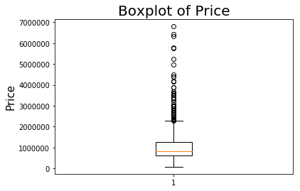

Slide 7
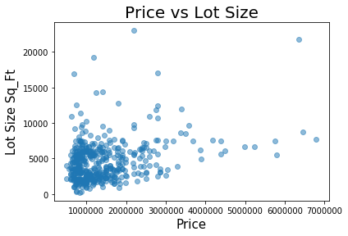

Slide 8
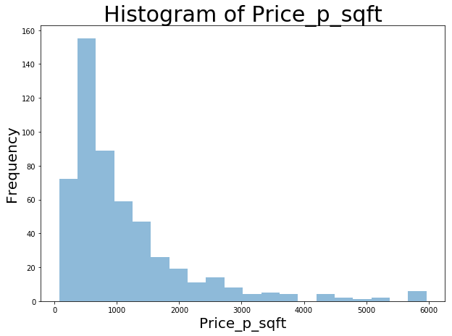

Slide 9
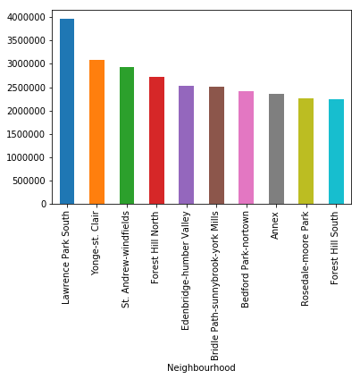
Top 10 Neighborhoods – Average Price

Slide 10
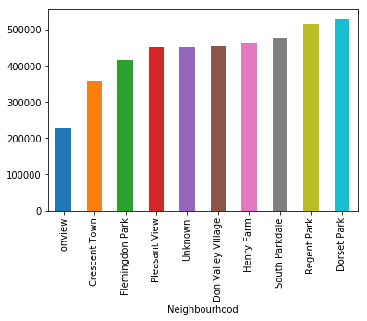
Bottom 10 Neighborhoods – Average Price

Slide 11
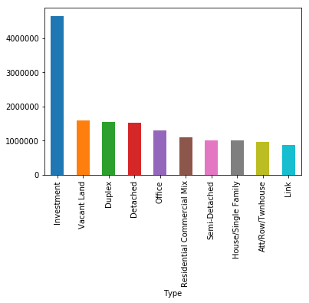
Top 10 Property Types – Average Price

Slide 12
Challenges
Data is incomplete / erroneous / dirty
What does it mean?
What is a key vs a value?
Python is unforgiving
Web Scraping warning
Store values in a dictionary for easy retrieval later

Slide 13
Future Steps
Consider scraping a more reliable site
Investigate metrics: age, walk score, days on site
Compare listing prices vs Sold price
Compare surrounding area and other cities
Maps
Machine Learning

